Slide 1
Requirements Management in Agile
- Prof K G Krishna

Slide 2


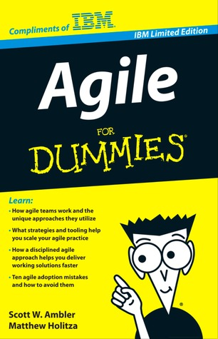
Text/Reference Books
T1
T2
Compliments of IBM
➔ As this field is evolutionary, the student is advised to stay tuned to the current and emerging practices by referring to their own organization’s documentation as well as Net sources

Slide 3
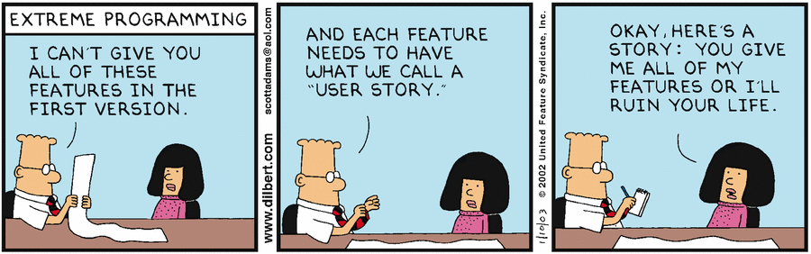
Topics
Agile Requirements Management
Managing Requirements Iteratively
User Stories as Requirements
Size/Effort Estimation
Prioritization Techniques
Preparing the Product Roadmap

Slide 4
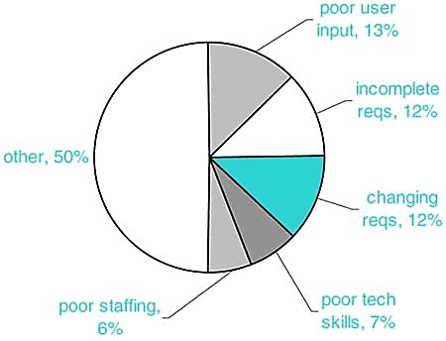
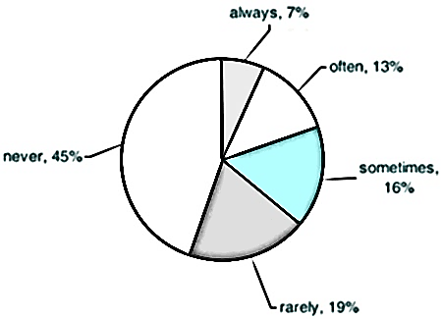
37% of Project Challenges are in Requirements Management
“Cost of fixing a Requirement defect increases non-linearly from early to late in the Project”
- B. Boehm, 1985
“45% of Features never used and ~20% rarely used”
Source: (T1) / Standish Group Report, 2004

Slide 5
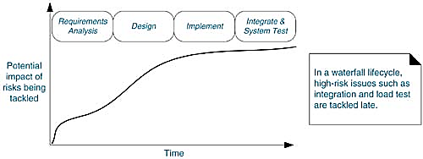
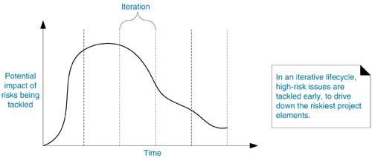
Incremental & Iterative Development (IID) is The Way To Go
Risk Profile in Waterfall Model
Risk Profile in IID
Source: (T1-Chap 5)

Slide 6
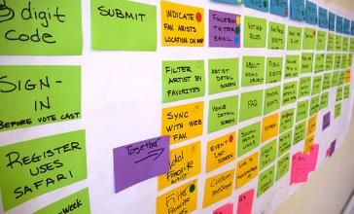
Identifying Product Requirements in Agile
From the Product Roadmap, arrive at Initial Set of High-priority Requirements
Product Roadmap ➔ Requirements ➔ Releases ➔ Sprints
Requirements ➔ Logical Groups
Decompose Requirements into: (level of detailing depends on early product definition)
Themes: logical grouping of features into Themes (Requirements at the highest level, e.g., Account Info, Transactions, Support functions,…)
Features: describe capability of the Product (part of the Product, e.g, view balance, pay bills, reset password, transfer money,…)
Epic User Stories: large set of Requirements that support a Feature containing multiple actions
User Stories: containing single action enough to start implementing (~ use-cases, scenarios)
Tasks: execution steps required to develop a story; breakdown User Story into Tasks during Sprint planning
Source: http://eleventwenty.com

Slide 7
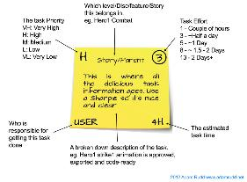
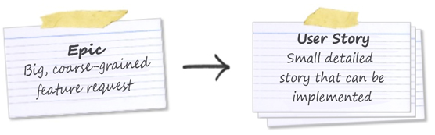
Building Product-backlog
Product-backlog comes to life soon after identification of first Requirement (Theme/Feature/Story)
User Story - an Expression of Requirement of Business Value
Group Features (into Themes) by Technical similarity, Usage flow, Business need, etc.
Use Index cards / Sticky Post-it notes for easy shuffling between Themes, Sprints and Product back-logs
A Meeting of Stakeholders (Customer) for Identifying and Grouping of Requirements
Source courtesy: http://www.bloomy.com

Slide 8
Size/Effort Estimation in Agile ➔ ➔

Slide 9
Relative Effort Estimation
Estimation & Ordering of Requirements commence soon after they are identified and arranged into logical Groups
Effort in Agile is not exact quantitative estimate, but an assessment of the ease or difficulty of implementing the Requirement
Ordering and Prioritizing is about determining its value in relation to other Requirements
Value implies how beneficial (customer value proposition) the Requirement is to the Product (when released to users)
Ordering of Requirements considers logical dependencies

Slide 10
Relative Scoring of Requirements
Relative Scoring of Requirements using “Fibonacci Sizing Sequence”
1, 2, 3, 5, 8, 13, 21, 34, 55, 89, 144, …
The effort-scores of Features (at high-level) during Product Roadmap creation will be high in the range, say 55 to 144
When the above are broken down into epic user stories, their scores will be in the range of 13 to 34
Upon further break down into low-level User Stories (ready for implementation), their scores should have effort scores between 1 and 8
Scoring is Relative (Value & Effort)
Chose a Requirement that a Project Team can agree has a small value and effort and score it, and use that Requirement as a Benchmark for furthering scoring of other Requirements
Use two separate Benchmarks for Value and Effort to calculate Relative Priority

Slide 11
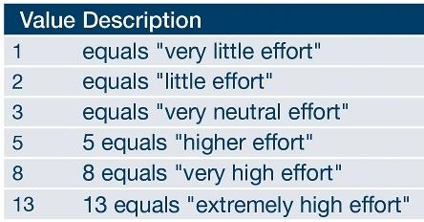
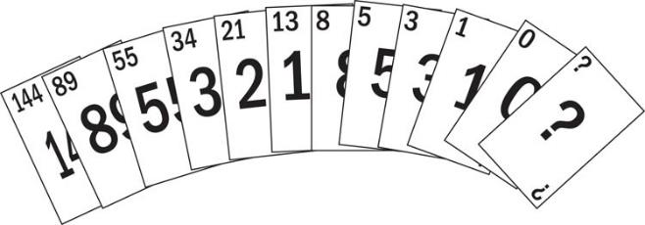
Effort Estimation by “Poker Estimation Game”
Estimation Poker (aka Planning Poker) is a fun game to determine Story size and build consensus
Scrum Master acts as a Facilitator and Product Owner provides reads the Story / provide details about the Feature to be estimated
The Card deck contains cards with numbers of the Fibonacci sequence
Why Fibonacci?
“Fibonacci series represents a set of numbers that we can intuitively distinguish between them as different magnitudes…”??
Source: www.platinumedge.com/estimationpoker

Slide 12
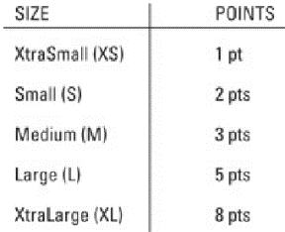
Poker Estimation (by Consensus) contd.,
Agree on Point-scale of about Six Numbers (representing Story Points)
Product Owner explains the User Story and provides relevant Information
Team (Players) briefly discusses the Story and guesses an estimate (Story Points)
Everyone silently selects one card (they felt represent the ‘effort’) and lays the card face-down
Once each Player selects a card, all players turn-over their cards simultaneously
If the Players have different Story points, it’s time for discussion; if the Players do not agree on any one estimate, it’s time for Scrum Master to mediate and decide or determine that the User Story needs more detailing
The above steps are repeated for each User Story to arrive at the collectively agreed Story Point estimates for all
When number of Stories are large, use Affinity Estimating – group Stories of similar affinity (effort value) and apply Poker Estimation to these categories (e.g. Extra-small, Small, Medium, Large, Extra-large, Epic user story that is too large to com into the Sprint)
Estimates should be for the total Done – Developed, Integrated, Tested and Documented

Slide 13
Relative Prioritizing of Requirements
After having Effort and Value scores for each Requirement, calculate Relative Priority as Value/Effort (and round the value to integer)
A Requirement with High Value and Low Effort will have High Relative Priority compared to the one with Low Value and High Effort
Relative Priority is just a mathematical idea to base decisions – however, any other equivalent technique can be used as well
To determine the Overall Priority answer the questions:
What is the Relative Priority (refer the above calculation)
What are the Prerequisites for any Requirement
What set of Requirements constitute a set for Release (of relative high value)

Slide 14
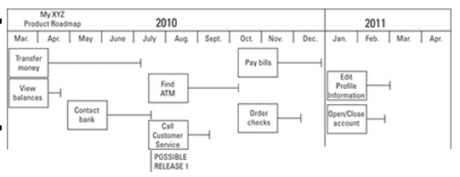
Build Product Roadmap with
Prioritized Requirements
Build Product-backlog with Feature set, and start arranging as per the Relative Priority computed
Source: (T2-Chap 7)

Slide 15
Summary: Agile Requirements
Continuous Requirements Churn is the Key Motivation for going Agile
Requirements are Evolutionary in Agile Projects – they continue to Change till the Last Release/Sprint
Requirements are organized into Themes→Features→Epic User Stories→User Stories→Tasks
All Size/Effort Estimations in Agile are Relative with baseline Estimation of a small User Story (unit of Requirements Capture/Estimation)
Estimations are made by Consensus (using Poker Estimation, Affinity Estimation)
Relative Prioritization of Estimates (by Value) helps in building Product Roadmap (→ Product-backlog)
Requirements are Managed at every Planning Stage in Agile – from Product Roadmap (Product-backlog) to Release Planning (Release-backlog) to Sprint Planning (Sprint-backlog)

Slide 16
Thank You
© Copyrights of original Authors are duly acknowledged
™ ® All Trademarks, Registered Trademarks referred in this document are the property of their respective owners

